Slide 1






Visualisasi Data Menggunakan
Studi Kasus Data COVID19
Prepared by : Aep Hidayatuloh
Email : aephidayatuloh.mail@gmail.com
GitHub : https://github.com/aephidayatuloh

Slide 2




{Aep Hidayatuloh}
Pendidikan | : Sarjana Statistika - Departemen Statistika FMIPA IPB University
Pengalaman | : Statistician & App Developer - PT Ganesha Cipta Informatika
 | Customer Value Management - PT Asuransi Jiwa Sequislife
 | Data Analyst - StarCore Analytics
GitHub | : https://github.com/aephidayatuloh
Email | : aephidayatuloh.mail@gmail.com
Rpubs | : https://rpubs.com/aephidayatuloh
telegram community
https://t.me/GNURIndonesia
Belajar GNU
R Indonesia

Slide 3
{Prerequisite}
Internet Connection
Software Installed:
R program [https://cran.r-project.org/]
RStudio [https://www.rstudio.com/products/rstudio/download/]
Data & Scripts:
Download from [https://github.com/aephidayatuloh/coviz]
R Packages:
dplyr : install.packages("dplyr")
ggplot2 : install.packages("ggplot2")
scales : install.packages("scales")
Atau jalankan perintah install.packages(c("dplyr", "ggplot2", "scales")) untuk install semua package tersebut.

Slide 4
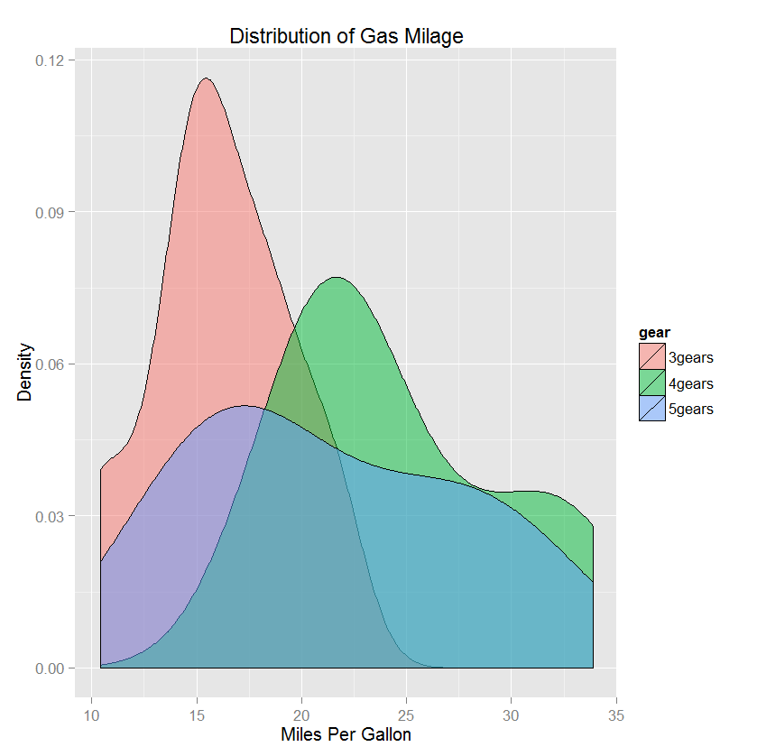
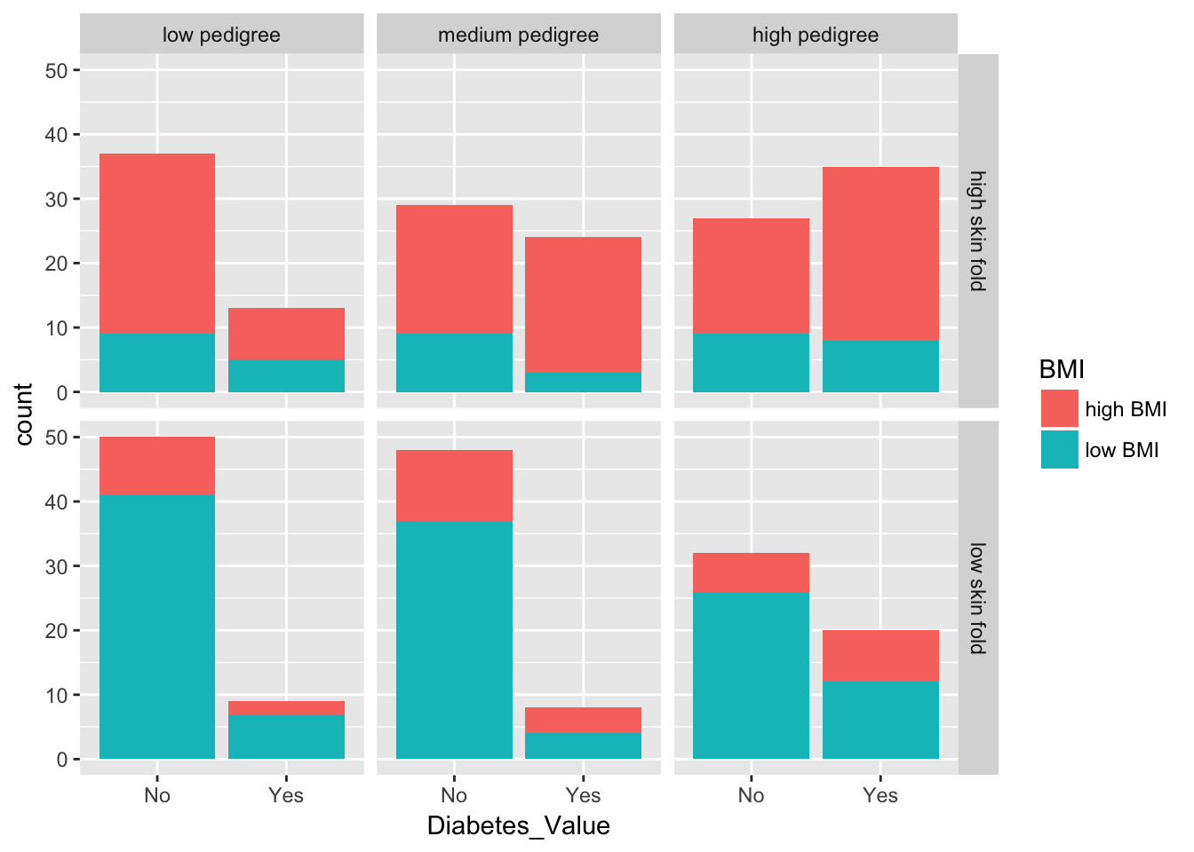
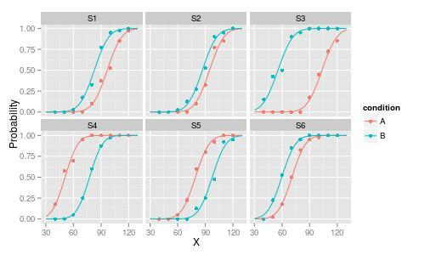
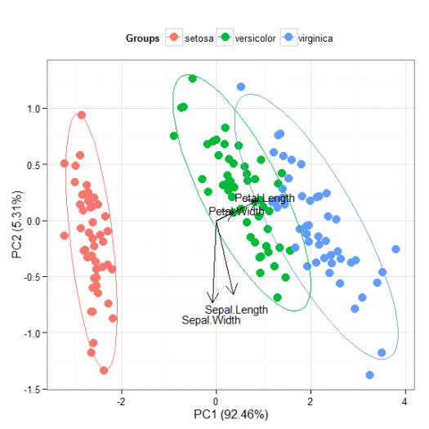
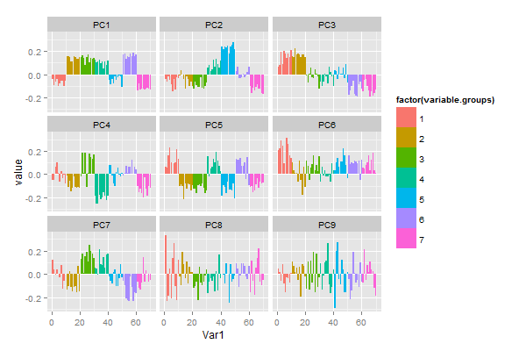
Have Seen Like This?

Slide 5

Have Seen Like This?

Slide 6
Objektif
visualisasi sederhana data covid19 menggunakan R & ggplot2
Source code, data dan file presentasi dapat diperoleh di
https://github.com/aephidayatuloh/coviz
https://rpubs.com/aephidayatuloh/coviz
Referensi
Wickham, H. 2016. ggplot2 : Elegant Graphics for Data Analysis Second Edition. Texas: Springer.
Grolemund G & Wickham, H. ____. R For Data Science. https://r4ds.had.co.nz.

Slide 7
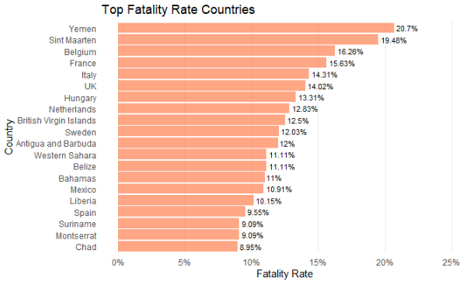
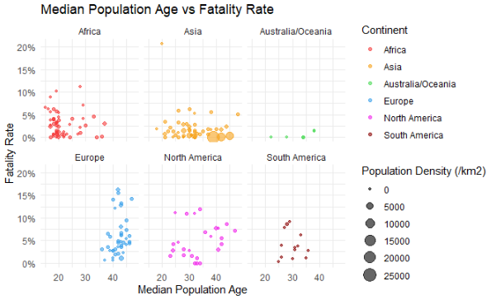
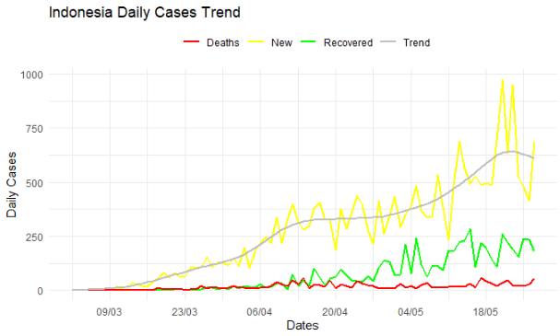
Visualisasi Covid19

Slide 8

The ggplot2, dplyr and pipe
Awesome Visualization
Great package for visualization in R
Powerful data management
Data manipulation and transformation in R became so easy
Pipeline in R
The dplyr imports this operator from another package (magrittr)
It’s the And Then

Slide 9
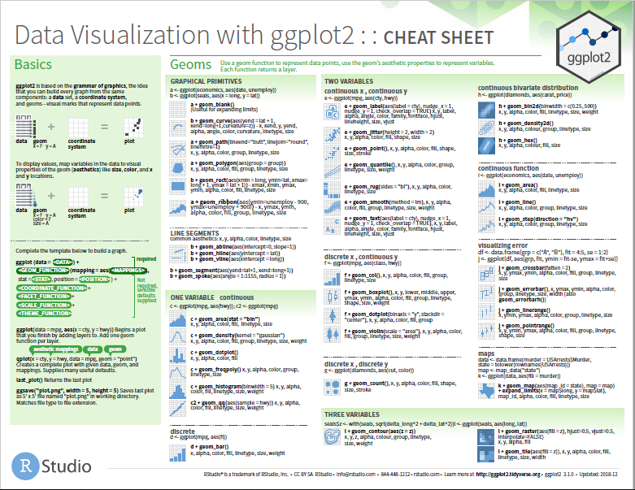
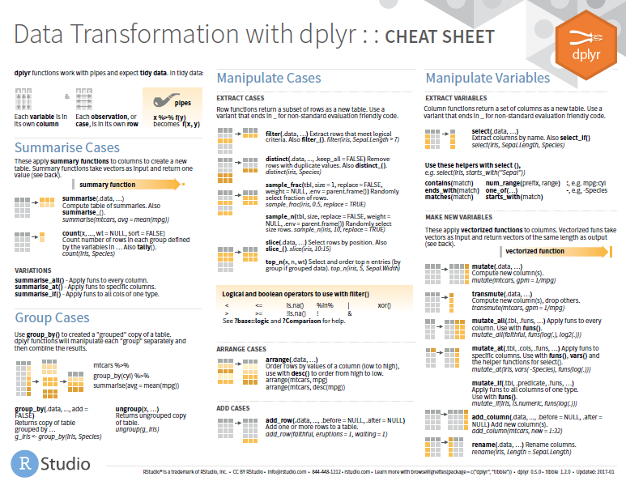
Cheat Sheets
https://www.rstudio.com/resources/cheatsheets/

Slide 10


Studi Kasus
Data yang digunakan diambil dan diolah dari
https://www.worldometers.info/coronavirus
https://www.worldometers.info/world-population/
https://bnpb-inacovid19.hub.arcgis.com/ (API)
Sumber gambar: https://covid19.kemenkes.go.id/
data/world_covid.csv
data/dailynational.csv

Slide 11
Lets {Code}!

Slide 12
{Visualisasi #1}

Slide 13

{Visualisasi #2}

Slide 14
{Visualisasi #3}

Slide 15
??? {Q & A}

Slide 16
ThankQ

